Slide 1
SUPPLY CHAIN MANAGEMENT -FMCG
Presenting by
Subham Patel

Slide 2
—W.Edwards Deming
“without data you are just another person with an opinion”

Slide 3
TABLE OF CONTENTS
01
02
03
04
05
06
Problem Statement & Appproach
Univariate Analysis
This describes the problem statement for the case study and the data driven approach
This describes the unique character of every individual feature.
Bivariate Analysis
Multivariate Analysis
This describes the behavior or influence of one feature over another
This describes the behavior or influence of one feature over several others.
Model Building
Conclusion & Recommendation
This part describes us which algorithm predictions are accurate
This part describes the inference of the analysis with conclusion and recommendation.

Slide 4

PROBLEM STATEMENT & APPROACH
01

Slide 5
Problem Statement
An FMCG company entered into the instant noodles business two years back. Their higher management has noticed that there is a miss match in the demand and supply. Where the demand is high, supply is pretty low and where the demand is low, supply is pretty high. In both ways, it is an inventory cost loss to the company; hence, the higher management wants to optimize the supply quantity in every warehouse in the entire country.

Slide 6
STRATEGIC OBJECTIVES
DATA CLEANING
DATA TRANSFORMATION
UNIVARIATE
ANALYSIS
BIVARIATE
ANALYSIS
MULTIVARIATE
ANALYSIS
Model
Building
BUSINESS CONCLUSION
DATA DUPLICATES
FEATURE ENGINEERING
BOX PLOTS
BAR CHART (HUE)
HEAT MAP
SPLITING
DATA INFERENCE
NULL VALUE
TREATMENT
DATA
MANIPULATION
DISTRIBUTION
PLOT
BOX PLOT (HUE)
FEATURE
SCALING
RECOMMENDATION
FEATURE ANALYSIS
KDE PLOT
COUNT PLOT (HUE)
MODEL TRAINING & TESTING
COUNT PLOT
OUTLIER TREATMENT
EVALUATING
THE FINAL ALGO

Slide 7
UNIVARIATE
ANALYSIS
02

Slide 8
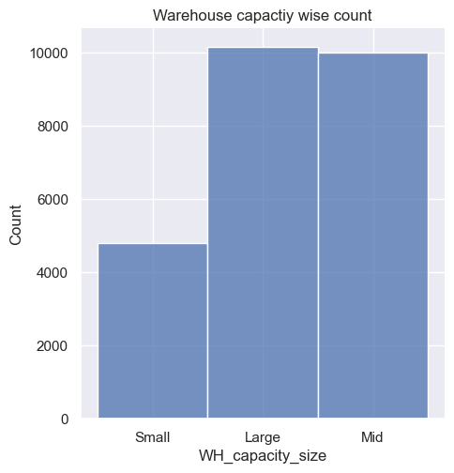
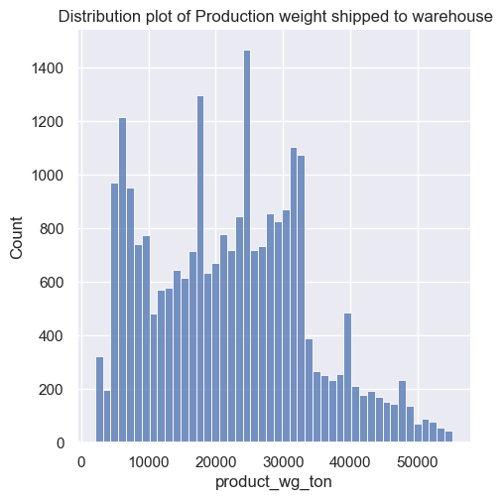
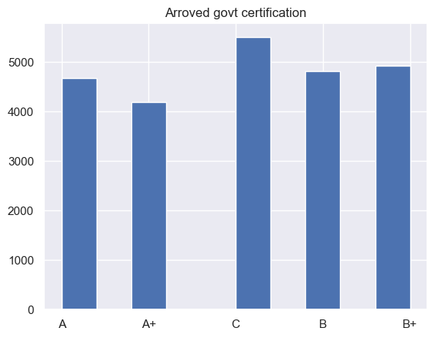


(A)
(B)
(C)
INFERENCE :
From chart (A) -Company have the same no of warehouse whose capacity is Large and Medium.
From chart (B) -We can observe the distribution pattern.
From chart (C) - Most of the warehouses fall in under “C” category followed by B+, A.

Slide 9
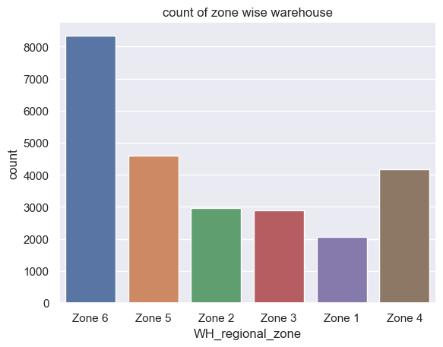
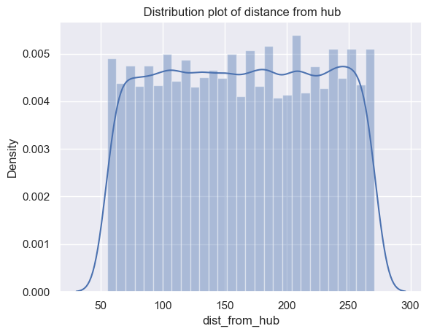
(A)
INFERENCE :
Chart(A)-Most numbers warehouses fall in Zone 6.
Chart(B)-Approx all the warehouse distances are equally distanced from their particular hub.
(B)

Slide 10
BI-VARIATE
ANALYSIS
03

Slide 11
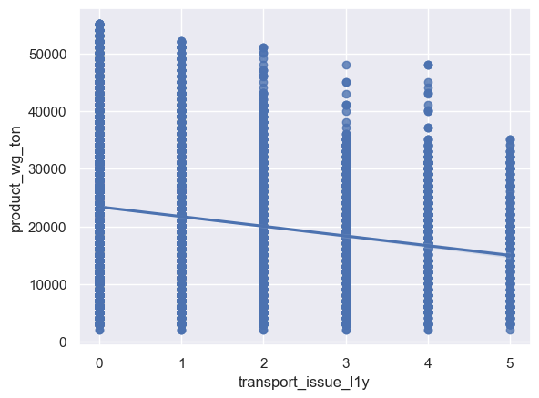
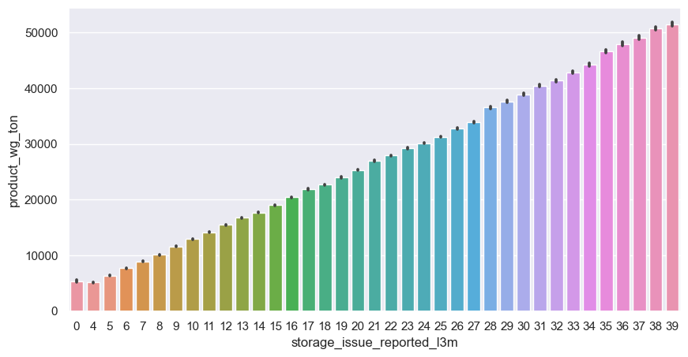
(A)
(B)
INFERENCE :
(A)-Transport issues are directly effecting the shipment.
(B)-There is a robust positive relationship between storage issue with shipped products of last 3 three months. As the shipment of products in the warehouse increases the storage issues also increases.

Slide 12
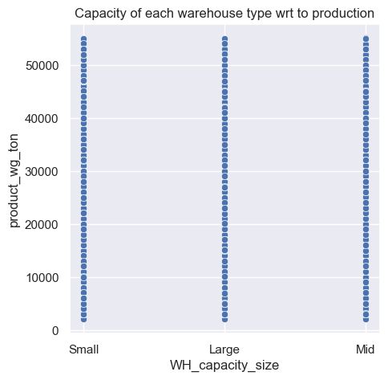
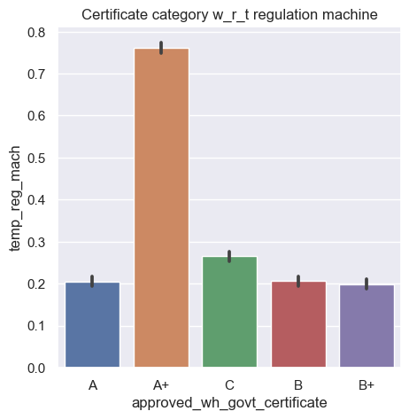
(A)
(B)
INFERENCE :
Chart A- Issues Small category warehouses are even had the production of more than 55K Ton in last 3 month
Chart B – Most of the Warehouses which are having temp reg machines got A certification from Government.

Slide 13
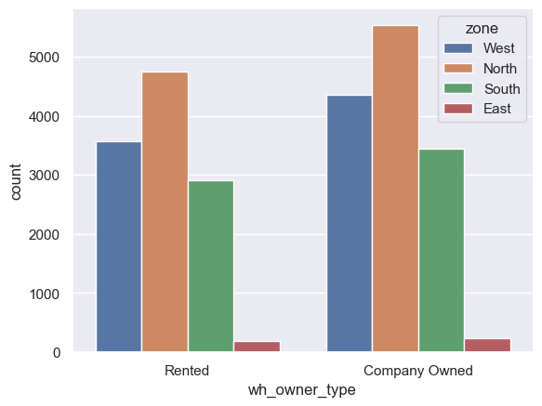
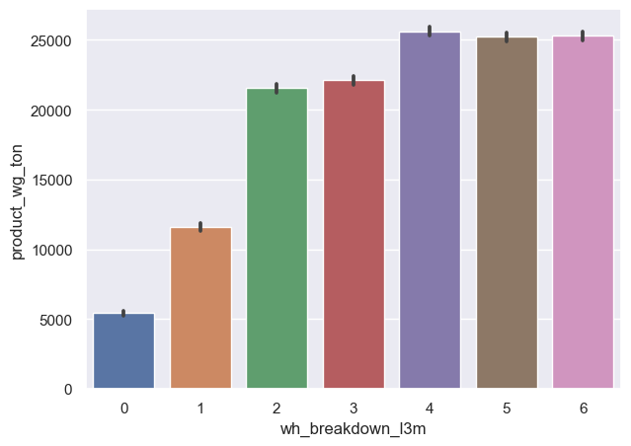
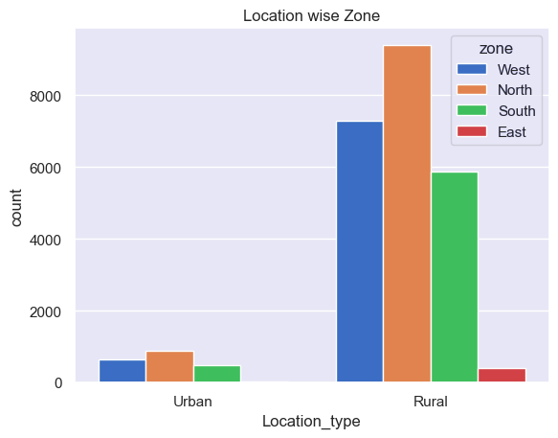
(A)
(C)
(B)
INFERENCE :
From chart A & B We can observed that Most of the warehouses are in North Zone and most of the warehouse are owned by company itself.
(B)-More breakdown occurring in the warehouse due to more production strorage.
(C)- Issues Small category warehouses are even had the production of more than 55K Ton.

Slide 14
MULTIVARIATE
ANALYSIS
04

Slide 15
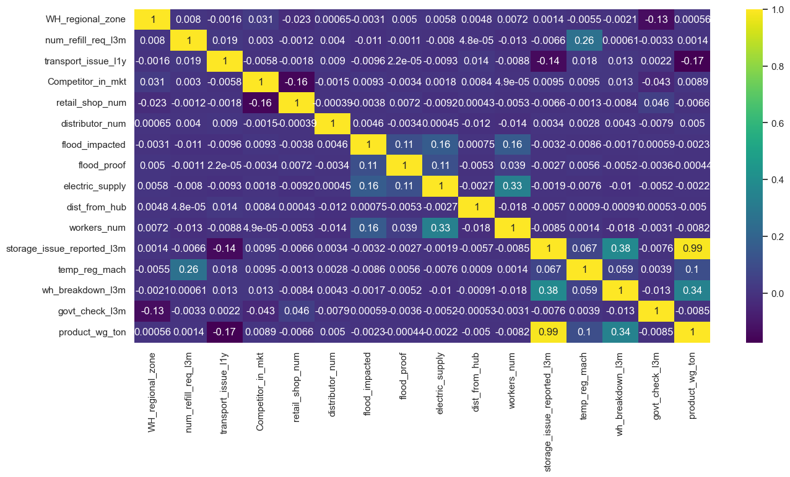
INFERENCE :
The storage issues reported during the last three months have a substantial impact on the sales shipments. This insight underscores the importance of addressing and optimizing storage management to enhance overall sales performance..

Slide 16
MODEL BUILDING
05

Slide 17

PRIORITIZATION MATRIX: DESCRIPTION
01
02
03
04
Splitting Dataset into Train & Test
Feature scaling with normalization.
Imported all the algorithms with whom we are going to Train & Test the model
Imported all the evaluation matrices to measure the performance.

Slide 18
CONCLUSION
06

Slide 19
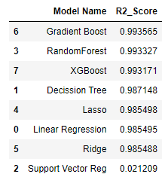
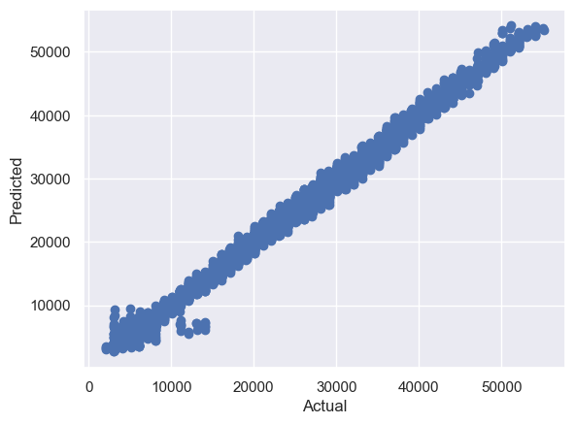
INFERENCE :
The gradient-boosting model which worked very effectively is resulted in accurate forecasts that very close to the true result.

Slide 20
CONCLUSION :
The application of data-driven machine learning techniques has shown its fruitfulness in resolving the imbalance between demand and supply within the fast-moving consumer goods (FMCG) sector of Noodles Company.
I conclude Gradient Boosting Regressor algorithm gives the best results as both train and test are not deviating and the R2 score is best in both Train and test cases.
In this case, Hyperparameter tuning is not required as we already achieved the best accuracy of 99.35% with RMSE of 932.83624, MSE of 870183.45205 & MAE of 698.07810
The demand forecasts generated by the Gradient Boosting model have the potential to substantially enhance the optimization of warehouse inventory. This will be cost efficiencies and minimized losses.
RECOMMENDATION:
1. Strategic Warehouse Placement: We saw plenty of warehouses placed in the north and rulal side, so management should make some strategy to allocate resources and streamline operations in these regions and unlock avenues for expansion
2. Storage Reporting Optimization: The strong positive correlation between storage reported during the last three months and product shipment underscores the importance of timely and accurate storage reporting. Implementing efficient reporting mechanisms can lead to improved sales outcomes.
3. Government Certification Focus: To get “A” certification from govt, the warehouse has to install an automated temp-regulated machine as per the analysis and also as a significant number of warehouses possess government-approved certificates of 'C' type, focusing on obtaining and maintaining such certifications can enhance credibility and trustworthiness.
4. Enhanced Predictive Modeling: By embracing the Gradient Boosting Regressor model with hyperparameter tuning, supply chain managers can harness its predictive prowess to optimize sales and inventory management.
5. Management should focus on their planning to tackle transportation issues which lead to shipment production.
6. Management should tackle the problem of breakdown which occurs with respect to increases in shipment production inside the warehouse.

Slide 21
Thank you

